Slide 2
Participants apply innovative methods and AI-driven tools to cultivate social-emotional learning (SEL) competencies among their students.
Outcome

Slide 3
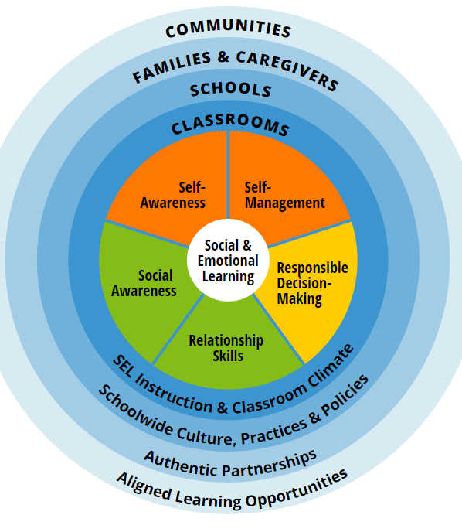
SEL= integral part of education and human development
SEL is the process through which all young
people and adults acquire and apply the
knowledge, skills, and attitudes to develop
healthy identities, manage emotions and
achieve personal and collective goals, feel and
show empathy for others, establish and
maintain supportive relationships, and make
responsible and caring decisions.

Slide 4
Why SEL matters so much?
Credits:https://casel.org/

Slide 5
What's AI Got To Do With It?

Slide 6
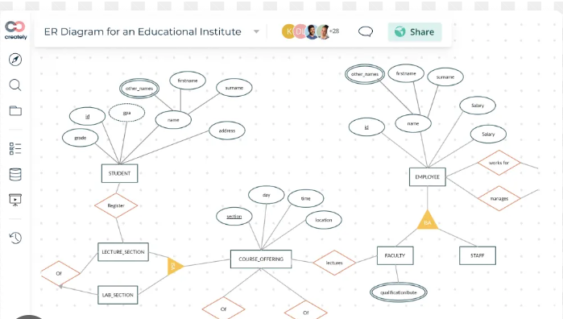
Sociograph as a teaching tool
discuss topics like social dynamics, peer relationships, empathy
visualize and understand the complex social interactions
teach and foster a more inclusive and understanding classroom environment
improve interpersonal relationships in your classroom

Slide 11
Ice-breaker....

Slide 14
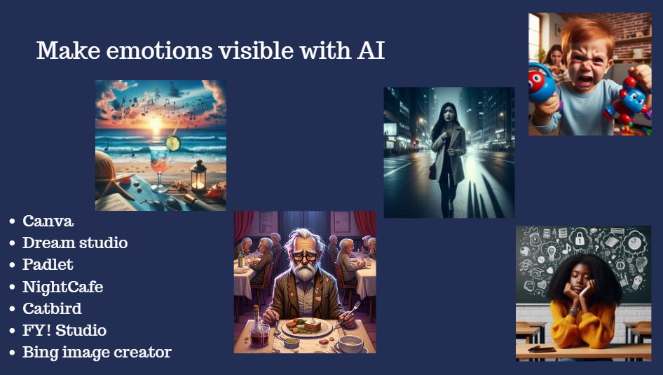
How do you feel today? What are you thinking about? Where are you? Write a prompt to generate an image!
Use the same prompt to generate lyrics and a song!
https://app.magicschool.ai/tools/colleague-song-generator
https://www.suno.ai/

Slide 15
Imagine a place where you would like to be right now.
Who is with you?
What are you doing?
What do you see around you?
How do you feel now?
Name your emotions!
Generate an image/lyrics/song!
Discuss the differences!

Slide 16
https://bit.ly/3Txghxl

Slide 17
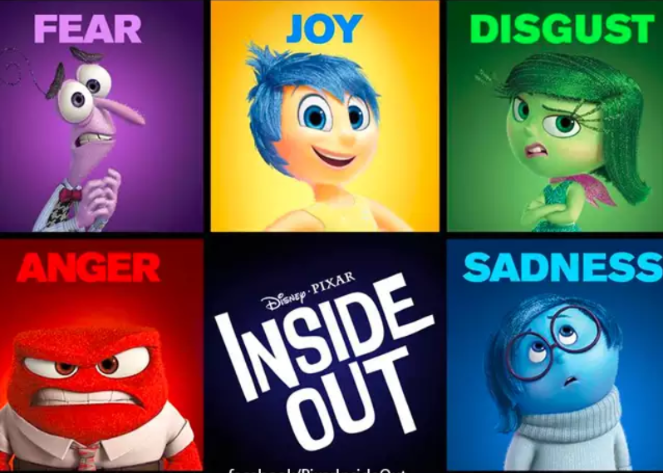
https://kiwi.video/

Slide 21
ChatGPT's tone modifiers
Tone (formal, assertive, empathetic,
angry) mood intention
Empathy and Perspective-Taking
Conflict Resolution and Emotional Regulation
M o

Slide 22
Angry, neutral or empathetic?
Hey, I need to tell you something because I can't stand your arbitrary decisions and imposition of opinions anymore. I constantly feel frustrated and uncomfortable when you're around because it always feels like you're imposing your views on me. You should think about how your behavior affects other people around you."
"Hey, I want to tell you something because I think it's important for us to communicate openly. I've noticed that we often have different opinions and views, which is normal and okay. However, I feel uncomfortable when you impose your views on others, including me. I think it would be good for us to talk about how we can improve our communication and mutual respect."
"Hey, I want to openly share something with you that I've been struggling with lately. I've noticed that we have different ways of thinking and don't always agree, which is okay because we're all different. However, sometimes I feel insecure and uncomfortable when your opinions are imposed on me and others. I understand that everyone has their own views, but I would like us to talk about how we can find common ground and better understand each other."

Slide 26
SEL+AI literacy for every student

Slide 27
Inclusion with Magic Student Tools
Topic: Emotions matter
CHARACTER CHATBOT
IDEA GENERATOR
SOCIAL STORIES
DEBATE PARTNER
REAL WORD CONNECTIONS
SONG GENERATOR
Task: Create your personal Self-care plan!

Slide 28
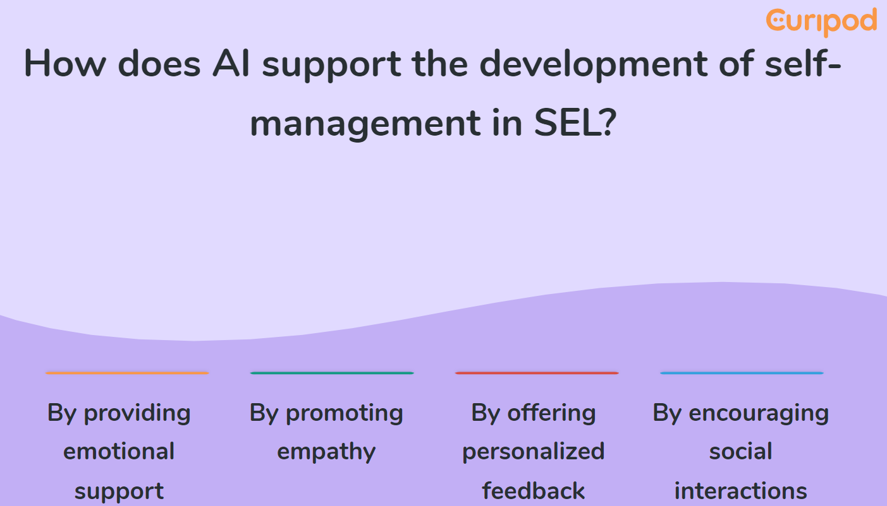
https://bit.ly/3VuLZ0E

